Slide 1
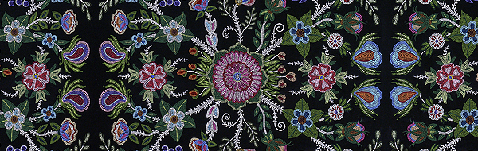
Statement of Acknowledgement of Traditional Land
“INFINITY” BY MÉTIS ARTIST CHRISTI BELCOURT
I (we) wish to acknowledge this land on which the University of Toronto operates. For thousands of years it has been the traditional land of the Huron-Wendat, the Seneca, and most recently, the Mississaugas of the Credit River. Today, this meeting place is still the home to many Indigenous people from across Turtle Island and we are grateful to have the opportunity to work on this land.
Notes:
I (we) wish to acknowledge this land on which the University of Toronto operates. For thousands of years it has been the traditional land of the Huron-Wendat, the Seneca, and most recently, the Mississaugas of the Credit River. Today, this meeting place is still the home to many Indigenous people from across Turtle Island and we are grateful to have the opportunity to work on this land.
“Acknowledging territory shows recognition of and respect for Aboriginal Peoples, which is key to reconciliation.” It is a statement of respect and a statement that provokes further thought and reflection. Purpose of acknowledgement also to acknowledge our position as newly arrived guests on this land, and to underscore our intent to highlight the impacts of settler colonialism on native peoples.

Slide 2
ABORIGINALS IN CANADA
A STUDY OF QUALITY OF LIFE INDICATORS FOR FIRST NATIONS, INUIT AND METIS PEOPLES
JOÃO PAULO CAMPOS MAIA PINTO
LUCIANA BERTHOLIM NASCIBEN
MAX LOUIS-JUSTE
ELIZABETH LOUISE SANTONATO
Notes:
We have taken as our subject the study of aboriginals in Canada…

Slide 3
AGENDA
Introduction & Problem Statement
Methods
Findings
Conclusions
Implications & Discussion

Slide 4
INTRODUCTION
Introduction & Problem Statement
Notes:
There is a huge and growing problem within the aboriginal populations of Canada. We know this because we see it across the country, in our cities, on our streets, and the news media is frequently reporting stories of boil water advisories on First Nations reserves, Prime Minister Trudeau campaigned on a series of promises for reconciliation with the First Nations, Inuit and Métis peoples of Canada, the Missing and Murdered Indigenous Women’s campaign received a lot of attention and has largely disappeared from the news although women continue to go missing or are found murdered in lakes and rivers across the country, we know that alcoholism and substance abuse is prevalent, a result of systemic abuse and suffering caused by the residential school system which removed children from their families by placing them in residential schools where they suffered physical, sexual and emotional abuses, punished for speaking their language or practicing their customs… yet today the First Nations peoples of Canada are beginning to thrive as the 7th generation is rising. A look at the Statistics Canada data reveals:

Slide 5
INTRODUCTION
The purpose of our study is to analyze the differences between the Aboriginal, and Non-Aboriginal, identity population in Canada in terms of specific quality of life indicators such as: access to health care services, perceived health status, frequency of diseases, and socioeconomic aspects (income, education, age structure).

Slide 6
PROBLEM STATEMENT
Problem statement
Notes:
We encountered many issues in locating and analyzing our data….

Slide 7
CURRENT STATISTICS
In 2016, there were 1,673,785 Aboriginal people in Canada, accounting for 4.9% of the total population. This was up from 3.8% in 2006 and 2.8% in 1996.
Statistics Canada, 2016 Census of Population

Slide 8
CURRENT STATISTICS
Since 2006, the Aboriginal population has grown by 42.5%—more than four times the growth rate of the non-Aboriginal population over the same period.
Statistics Canada, 2016 Census of Population

Slide 9
Insert population breakdown chart
(new visualization needed)

Slide 10
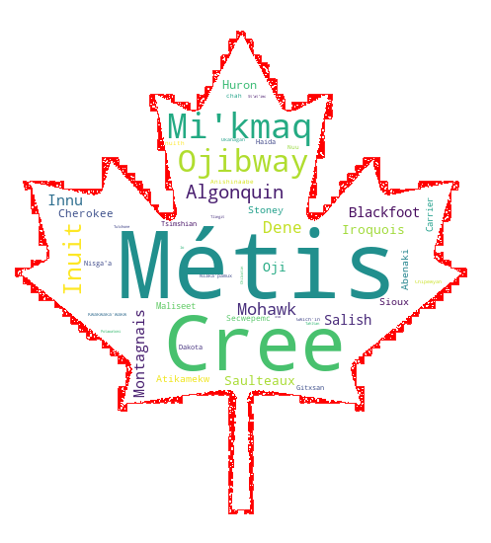
Questions and concerns
What does the future look like for aboriginal peoples in Canada?
What key quality of life indicators can we look to for analysis?
What dataset information is publicly available for study?
Who has jurisdiction over the areas where people live?
Who has jurisdiction over the data
Notes:
Legacy of colonialism continues as communities are marginalized and segregated via reserves

Slide 11
RESEARCH QUESTIONS
What is the distribution of aboriginal population throughout the national provinces?
What is the proportion of aboriginal population on and off reserves
How do we compare the access to healthcare services (medical doctor for example) for both population?
Contact with a medical doctor in the past 12 months
Has a regular medical doctor
Health habits
Identify Variables
Current smoker, daily or occasional
Food Insecurity, moderate or severe
Fruit and vegetable consumption, 5 times or more per day
Chronic diseases
Diabetes
5 or more drinks on one occasion, at least once a month in the past year
Never had alcoholic drinks in the past 12 months
High blood pressure, heart disease or suffering from effects of stroke
One or more chronic conditions
Respiratory problems
Perceived health
Perceived health, very good or excellent
Perceived health, fair or poor
What are the difference in terms of age structure, income and education for all groups?
How do we compare Influenza immunization for both population?
Variables
Influenza immunization, less than one year ago

Slide 12
RESEARCH FINDINGS
Population Per Province
Population YOY increase (pending)
Population Age Per Province/Reserve
Education per Province/Reserve
Income Per Province/Reserve
Community Well-Being Index
Health
Access to Food
Suicide (pending)

Slide 14
Notes:
Distribution of funds to reserves, no data on how funds are spent within reserves

Slide 16
Map of Aboriginal Ancestry survey responses

